Slide 1
Quality Predictions In The Mining Process
ML 3253 – University Of Toronto – August 2019

Slide 2
AGENDA
1
2
3
Problem
Solution
Key Outcomes

Slide 3




THE TEAM
Adam Gregg
Nisarg Patel
Omar Hamdy
Khurram Shafiq
Physics,
University Of Toronto
Mechatronics Eng. McMaster University
Chemical Eng.
University Of Toronto
Computer Eng.
University Of Ottawa

Slide 4
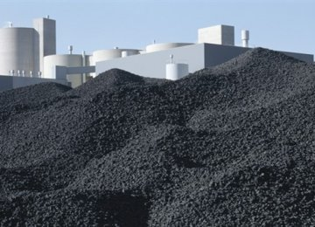
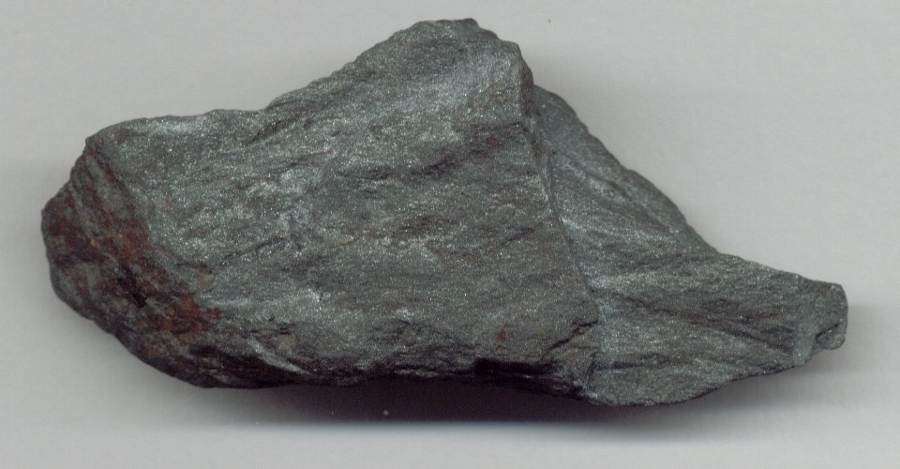

PROBLEM STATEMENT
Predicting % Silica (Impurity) present in the Iron Ore concentrate

Slide 5
BACKGROUND PROCESS
Iron Ore
Flotation Plant
[Physical Separation]
% Silica
Other

Slide 6
DATASET
# of Instances | 737,453
# of columns | 24
Target Variable | % Silica Concentrate
Data Collection Period | 20 seconds
Output Update Period | 2 hours
Range | 6 months
Missing Values | None
Problem Type | Supervised - Regression
Dataset retrieved from: https://www.kaggle.com/edumagalhaes/quality-prediction-in-a-mining-process

Slide 7
DATA PREPARATION
Item | Approach # 1 | Approach # 2
Sampling Period | 20 seconds | 1 hour
Outlier Detection & Removal | Z Score | Box-plots & IQR Score
Feature Selection | Manual | Semi-automatic
----------Output----------
Total Features | 6 (2 – engineered) | 8 (2 – engineered)
Target Variable | 1 | 1
# of Instances | 346,000 | 1,817

Slide 8
ML MODELLING JOURNEY
Split Data
Built Pipeline
Scaling
ML Model
Train Model
Evaluate Base Model
Hyperparameter Tuning
Re-evaluate Model
Finalize

Slide 9
ML MODELLING
Item | Model # 1 | Model # 2
Base Algorithms Used | LinearRegression,, KNeighborsRegressor, RandomForestRegressor, GradientBoostingRegressor, SGDRegressor
Other Algorithms Used | Decision Tree Regressor, Ridge, Lasso | SVR
Scaling Data | Min_Max Scaler | Standard Scaler
Test Train Split | 75% (train) - 25% (test) | 70% (train) - 30% (test)
Cross Validation | K-folds 10 split
Hyperparameter Tuning | Grid Search
Scoring Methods | RMSE, R^2, Accuracy

Slide 10
RESULTS

Slide 11
RESULTS
Before Tuning
Scoring | Model # 1 – Random Forest Regressor | Model # 2 – Gradient Boosting Regressor
RMSE | 0.282 | 0.913
R^2 | 0.897 | 0.221
Accuracy | 93.64 % | 62.24 %
After Tuning
RMSE | 0.282 | 0.907
R^2 | 0.908 | 0.232
Accuracy | 93.80 % | 62.89 %

Slide 12
KEY OUTCOMES
Produced a generalized model that predicts % Silica (Impurity) present in the Iron Ore concentration with accuracy of:
93.80 %
62.90 %
Full Dataset
Resampled Dataset

Slide 13
NEXT STEPS
Revisit and align on sampling period
Consult with business to enhance the understanding of the data
Perform in-depth hyper-parameter tuning on cloud computer (GCP, AWS, Azure)
Experiment with different ML Packages / Libraries (Spark Mllib, TensorFlow)
Use time series forecast to Predict Features (X) at a given time to Predict % Silica (Y)

Slide 14

THANK YOU
https://github.com/nishp763/SCS-ML-3253---Final-Project.git

